Slide 1

Perceptual Pyramid Adversarial Networks for Text-to-Image Synthesis
Lianli Gao, Daiyuan Chen, Jingkuan Song, Xing Xu, Dongxiang Zhang, HengTao Shen
University of Electronic Science and Technology of China

Slide 2
Outline
Introduction
Related Work
Our Method
Experiments

Slide 3
Outline
Introduction
Related Work
Our Method
Experiments and Results

Slide 4
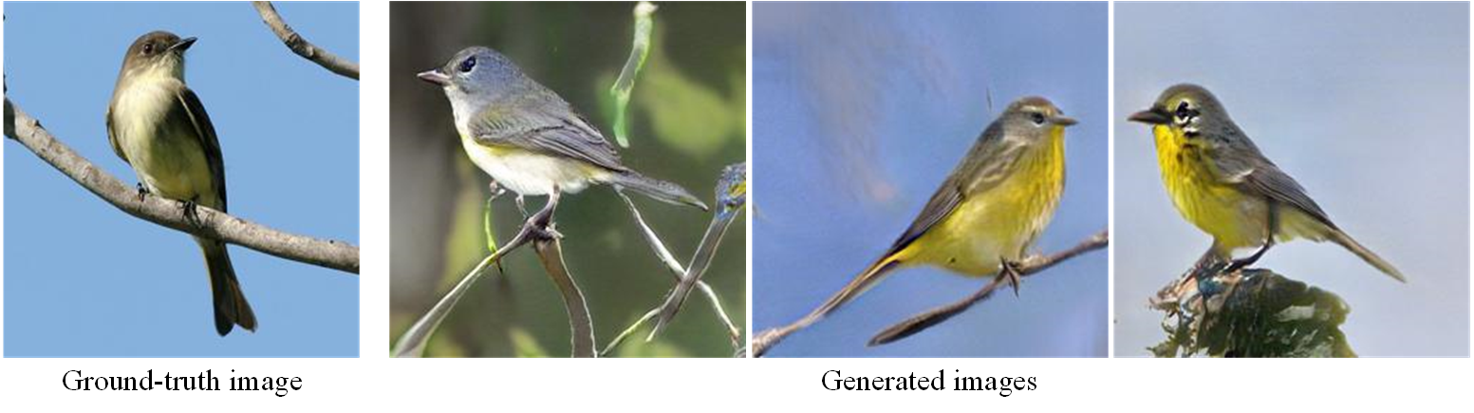
Introduction
Problem Statement
Text-to-image synthesis : generating various and natural images that match text
descriptions, not just only like the ground truth
Inputting text:
A small bird with yellow and gray throat and belly , and darker crown, wings and tail feathers

Slide 5
Introduction
Problem Statement
Text-to-image synthesis : generating various and natural images that match text
descriptions, not just only like the ground truth
Text input:
A small bird with yellow and gray throat and belly, and darker crown, wings and tail feathers

Slide 6
Introduction
Problem Statement
Text-to-image synthesis : generating various and natural images that match text
descriptions, not just only like the ground truth
Inputting text:
A small bird with yellow and gray throat and belly , and darker crown, wings and tail feathers

Slide 7
Outline
Introduction
Related Work
Our Method
Experiments and Results

Slide 8
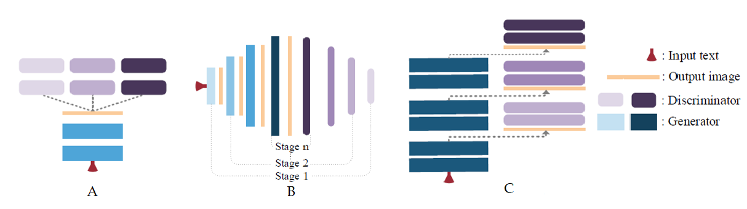
Related work
State-of-the-Arts
A:
training one G and multiple Ds, directly
B:
training multi-pair GANs , stage-by-stage
C:
training a single-stream G with hierarchically-nested Ds, end-to-end

Slide 9
Outline
Introduction
Related Work
Our Method
Experiments and Results

Slide 10
Our Method
Motivations
Most existed methods use multi-GANs, so that training procedure is very difficult to converge. So we focus on how to design a highly structured network to simplify the training process.
How to enriches effectively multi-scale feature representations to generate different resolution images?
How to guarantee semantic consistency, image fidelity and class invariance of generated images ?
Notes:
[1] M. Grundmann, V. Kwatra, M. Han, and I. Essa. Efficient hierarchical graph-based video segmentation. In CVPR, pages 2141–2148, 2010.
[2] H. Jiang, G. Zhang, H. Wang, and H. Bao. Spatio-temporal video segmentation of static scenes and its applications. IEEE Trans. Multimedia, 17(1):3–15, 2015.
[3] F. Galasso, M. Keuper, T. Brox, and B. Schiele. Spectral graph reduction for efficient image and streaming video segmentation. In CVPR, 2014.
[4] C.-P. Yu, H. Le, G. Zelinsky, and D. Samaras. Efficient video segmentation using parametric graph partitioning. In ICCV, 2015.

Slide 11
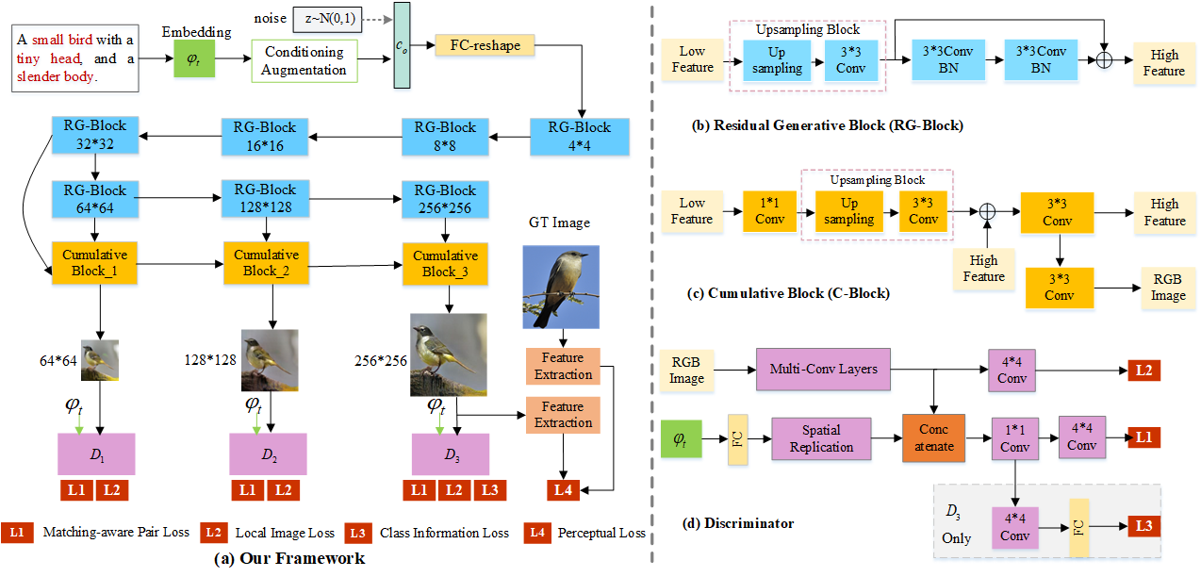
Our Method
Perceptual Pyramid Adversarial Network (PPAN)
Notes:
[1] M. Grundmann, V. Kwatra, M. Han, and I. Essa. Efficient hierarchical graph-based video segmentation. In CVPR, pages 2141–2148, 2010.
[2] H. Jiang, G. Zhang, H. Wang, and H. Bao. Spatio-temporal video segmentation of static scenes and its applications. IEEE Trans. Multimedia, 17(1):3–15, 2015.
[3] F. Galasso, M. Keuper, T. Brox, and B. Schiele. Spectral graph reduction for efficient image and streaming video segmentation. In CVPR, 2014.
[4] C.-P. Yu, H. Le, G. Zelinsky, and D. Samaras. Efficient video segmentation using parametric graph partitioning. In ICCV, 2015.

Slide 12
Our Method
Conditioning Augmentation (CA):
producing additional condition c0 to guide images generation
Notes:
[1] M. Grundmann, V. Kwatra, M. Han, and I. Essa. Efficient hierarchical graph-based video segmentation. In CVPR, pages 2141–2148, 2010.
[2] H. Jiang, G. Zhang, H. Wang, and H. Bao. Spatio-temporal video segmentation of static scenes and its applications. IEEE Trans. Multimedia, 17(1):3–15, 2015.
[3] F. Galasso, M. Keuper, T. Brox, and B. Schiele. Spectral graph reduction for efficient image and streaming video segmentation. In CVPR, 2014.
[4] C.-P. Yu, H. Le, G. Zelinsky, and D. Samaras. Efficient video segmentation using parametric graph partitioning. In ICCV, 2015.

Slide 13
Our Method
Residual Generative Blocks (RG-Blocks):
capturing the textual features and
generating the visual features
Notes:
[1] M. Grundmann, V. Kwatra, M. Han, and I. Essa. Efficient hierarchical graph-based video segmentation. In CVPR, pages 2141–2148, 2010.
[2] H. Jiang, G. Zhang, H. Wang, and H. Bao. Spatio-temporal video segmentation of static scenes and its applications. IEEE Trans. Multimedia, 17(1):3–15, 2015.
[3] F. Galasso, M. Keuper, T. Brox, and B. Schiele. Spectral graph reduction for efficient image and streaming video segmentation. In CVPR, 2014.
[4] C.-P. Yu, H. Le, G. Zelinsky, and D. Samaras. Efficient video segmentation using parametric graph partitioning. In ICCV, 2015.

Slide 14
Our Method
Cumulative Blocks (C-Blocks):
enriching effectively multi-scale feature representations
Notes:
[1] M. Grundmann, V. Kwatra, M. Han, and I. Essa. Efficient hierarchical graph-based video segmentation. In CVPR, pages 2141–2148, 2010.
[2] H. Jiang, G. Zhang, H. Wang, and H. Bao. Spatio-temporal video segmentation of static scenes and its applications. IEEE Trans. Multimedia, 17(1):3–15, 2015.
[3] F. Galasso, M. Keuper, T. Brox, and B. Schiele. Spectral graph reduction for efficient image and streaming video segmentation. In CVPR, 2014.
[4] C.-P. Yu, H. Le, G. Zelinsky, and D. Samaras. Efficient video segmentation using parametric graph partitioning. In ICCV, 2015.

Slide 15
Our Method
Multi-purpose discriminators:
discriminating encourage semantic consistency, image fidelity
and class invariance of images
Notes:
[1] M. Grundmann, V. Kwatra, M. Han, and I. Essa. Efficient hierarchical graph-based video segmentation. In CVPR, pages 2141–2148, 2010.
[2] H. Jiang, G. Zhang, H. Wang, and H. Bao. Spatio-temporal video segmentation of static scenes and its applications. IEEE Trans. Multimedia, 17(1):3–15, 2015.
[3] F. Galasso, M. Keuper, T. Brox, and B. Schiele. Spectral graph reduction for efficient image and streaming video segmentation. In CVPR, 2014.
[4] C.-P. Yu, H. Le, G. Zelinsky, and D. Samaras. Efficient video segmentation using parametric graph partitioning. In ICCV, 2015.

Slide 16
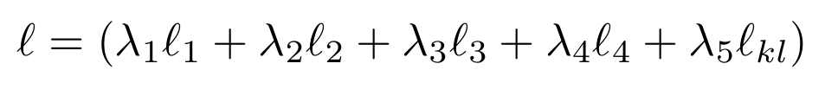
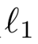
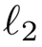
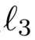
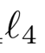
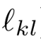
Our Method
Final loss
min
: Matching-aware pair loss encourages semantic consistency
: Local image loss improves image fidelity
: Class information loss guarantees class invariance
: Perceptual loss helps image diversity
: Kullback-Leibler loss constrains conditioning Gaussian distribution
Notes:
[1] M. Grundmann, V. Kwatra, M. Han, and I. Essa. Efficient hierarchical graph-based video segmentation. In CVPR, pages 2141–2148, 2010.
[2] H. Jiang, G. Zhang, H. Wang, and H. Bao. Spatio-temporal video segmentation of static scenes and its applications. IEEE Trans. Multimedia, 17(1):3–15, 2015.
[3] F. Galasso, M. Keuper, T. Brox, and B. Schiele. Spectral graph reduction for efficient image and streaming video segmentation. In CVPR, 2014.
[4] C.-P. Yu, H. Le, G. Zelinsky, and D. Samaras. Efficient video segmentation using parametric graph partitioning. In ICCV, 2015.

Slide 17
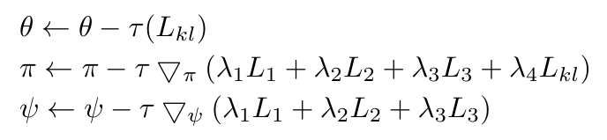
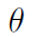
Our Method
Learning (Back Propagation)
Where is conditioning augmentation network parameters,
is the generator parameters, is the discriminators parameters, and is the learning rate.
Notes:
[1] M. Grundmann, V. Kwatra, M. Han, and I. Essa. Efficient hierarchical graph-based video segmentation. In CVPR, pages 2141–2148, 2010.
[2] H. Jiang, G. Zhang, H. Wang, and H. Bao. Spatio-temporal video segmentation of static scenes and its applications. IEEE Trans. Multimedia, 17(1):3–15, 2015.
[3] F. Galasso, M. Keuper, T. Brox, and B. Schiele. Spectral graph reduction for efficient image and streaming video segmentation. In CVPR, 2014.
[4] C.-P. Yu, H. Le, G. Zelinsky, and D. Samaras. Efficient video segmentation using parametric graph partitioning. In ICCV, 2015.

Slide 18
Outline
Introduction
Related Work
Our Method
Experiments and Results

Slide 19
Experiments
CUB Dataset
It contains 8855 and 2933 images for training and testing, totally belonging to 200 categories. Each image is provided 10 text descriptions.
Oxford-102
It consists of 7034 and 1155 images for training and testing, a total of 102 categories. Each image is provided 10 text descriptions.
Notes:
If the task is unspecified as a general video segmentation task, then there is an ambiguity of the correct level of granularity on the ground truth segments, and different human annotators would show different acceptable ways to segment the video. And one can see the agreement among the human annotators are around 80%-90% percent. Especially, they tend to agree on the main subjects but differ on the background ones.
It unifies video and image segmentation benchmark together and allows the testing of coarse-to-fine methods because it
Simple baseline like image segmentation + optical flow actually outperforms all the tested video segmentation methods.

Slide 20
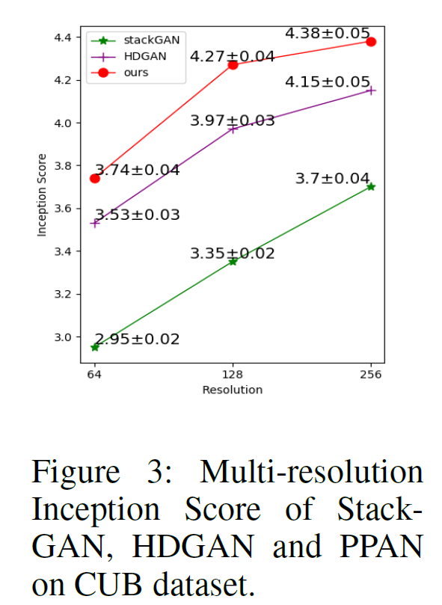
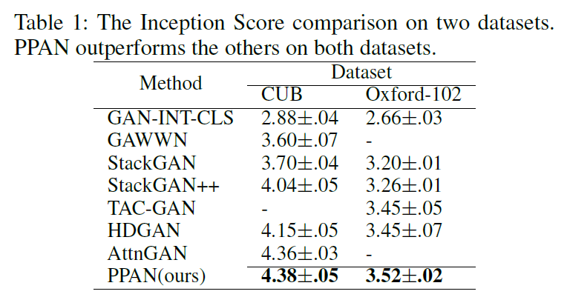
Experiments
Inception Score (IS)
IS measures both objectiveness and diversity of images.
Notes:
If the task is unspecified as a general video segmentation task, then there is an ambiguity of the correct level of granularity on the ground truth segments, and different human annotators would show different acceptable ways to segment the video. And one can see the agreement among the human annotators are around 80%-90% percent. Especially, they tend to agree on the main subjects but differ on the background ones.
It unifies video and image segmentation benchmark together and allows the testing of coarse-to-fine methods because it
Simple baseline like image segmentation + optical flow actually outperforms all the tested video segmentation methods.

Slide 21
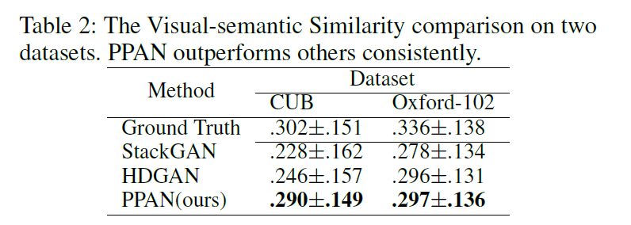
Experiments
Visual-semantic Similarity(VS)
VS measures the alignment between generated images and conditioned texts.
Notes:
If the task is unspecified as a general video segmentation task, then there is an ambiguity of the correct level of granularity on the ground truth segments, and different human annotators would show different acceptable ways to segment the video. And one can see the agreement among the human annotators are around 80%-90% percent. Especially, they tend to agree on the main subjects but differ on the background ones.
It unifies video and image segmentation benchmark together and allows the testing of coarse-to-fine methods because it
Simple baseline like image segmentation + optical flow actually outperforms all the tested video segmentation methods.

Slide 22
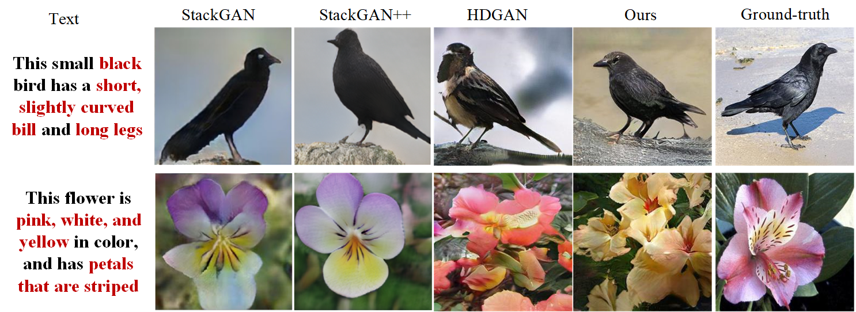
Experiments
Qualitative Results
Notes:
If the task is unspecified as a general video segmentation task, then there is an ambiguity of the correct level of granularity on the ground truth segments, and different human annotators would show different acceptable ways to segment the video. And one can see the agreement among the human annotators are around 80%-90% percent. Especially, they tend to agree on the main subjects but differ on the background ones.
It unifies video and image segmentation benchmark together and allows the testing of coarse-to-fine methods because it
Simple baseline like image segmentation + optical flow actually outperforms all the tested video segmentation methods.

Slide 23
Experiments
t-SNE Results
HDGAN Ours
Notes:
If the task is unspecified as a general video segmentation task, then there is an ambiguity of the correct level of granularity on the ground truth segments, and different human annotators would show different acceptable ways to segment the video. And one can see the agreement among the human annotators are around 80%-90% percent. Especially, they tend to agree on the main subjects but differ on the background ones.
It unifies video and image segmentation benchmark together and allows the testing of coarse-to-fine methods because it
Simple baseline like image segmentation + optical flow actually outperforms all the tested video segmentation methods.

Slide 24
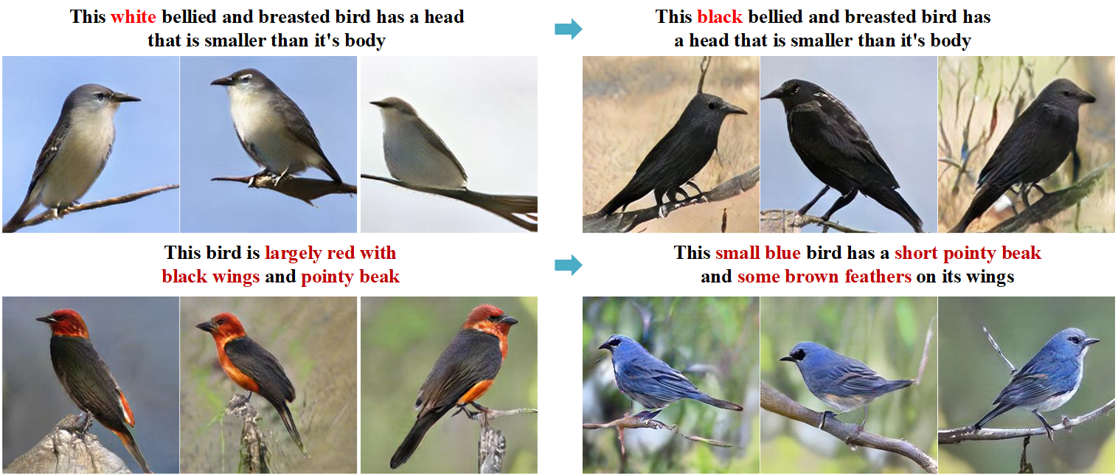

Experiments
Sentence Interpolation
Notes:
If the task is unspecified as a general video segmentation task, then there is an ambiguity of the correct level of granularity on the ground truth segments, and different human annotators would show different acceptable ways to segment the video. And one can see the agreement among the human annotators are around 80%-90% percent. Especially, they tend to agree on the main subjects but differ on the background ones.
It unifies video and image segmentation benchmark together and allows the testing of coarse-to-fine methods because it
Simple baseline like image segmentation + optical flow actually outperforms all the tested video segmentation methods.

Slide 25
Conclusions
We propose Perceptual Pyramid Adversarial Network (PPAN), which optimizes largely the training procedure of text-to-image.
PPAN has a highly structured network, which consists of one generator and three multi-purpose discriminators.
Multi-purpose GAN guarantees semantic consistency, image fidelity and class invariance of generated images.
Experiments on two datasets show that PPAN can outperform other methods to achieve the state-of-the-art performance in Inception Score and Visual-semantic Similarity.
Notes:
If the task is unspecified as a general video segmentation task, then there is an ambiguity of the correct level of granularity on the ground truth segments, and different human annotators would show different acceptable ways to segment the video. And one can see the agreement among the human annotators are around 80%-90% percent. Especially, they tend to agree on the main subjects but differ on the background ones.
It unifies video and image segmentation benchmark together and allows the testing of coarse-to-fine methods because it
Simple baseline like image segmentation + optical flow actually outperforms all the tested video segmentation methods.

Slide 26
Q&A
Notes:
If the task is unspecified as a general video segmentation task, then there is an ambiguity of the correct level of granularity on the ground truth segments, and different human annotators would show different acceptable ways to segment the video. And one can see the agreement among the human annotators are around 80%-90% percent. Especially, they tend to agree on the main subjects but differ on the background ones.
It unifies video and image segmentation benchmark together and allows the testing of coarse-to-fine methods because it
Simple baseline like image segmentation + optical flow actually outperforms all the tested video segmentation methods.

